Slide 1
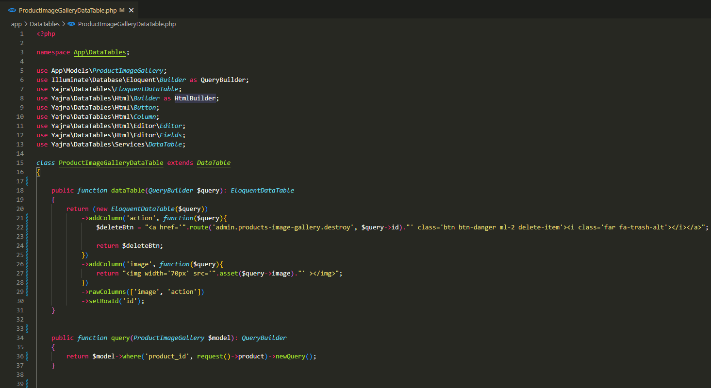
app\DataTables\ProductImageGalleryDataTable.php

Slide 2
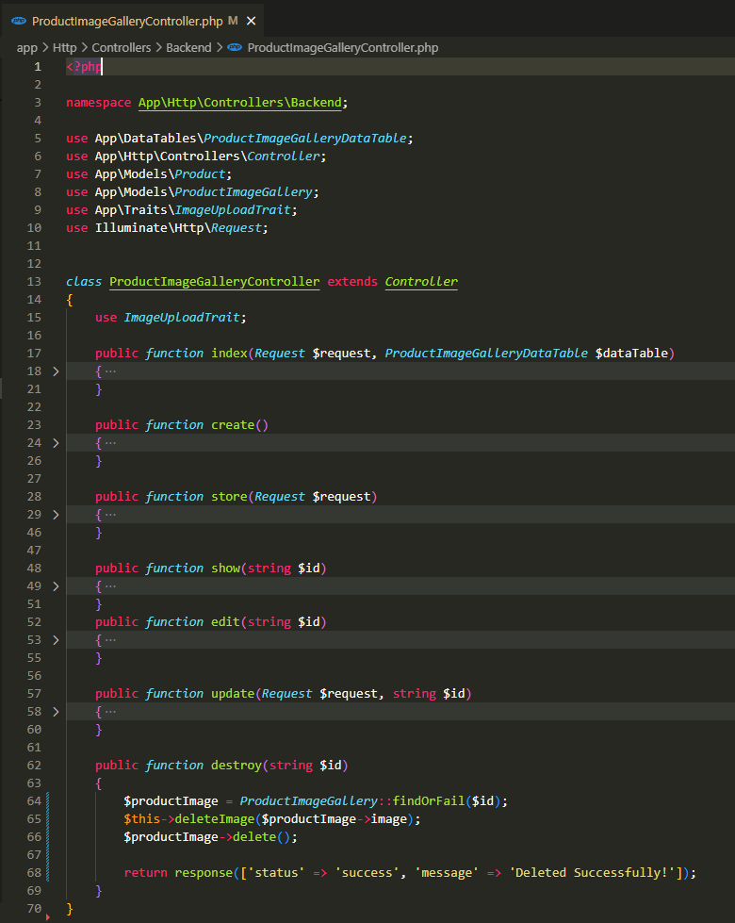
app\Http\Controllers\Backend\ProductImageGalleryController.php

Slide 3
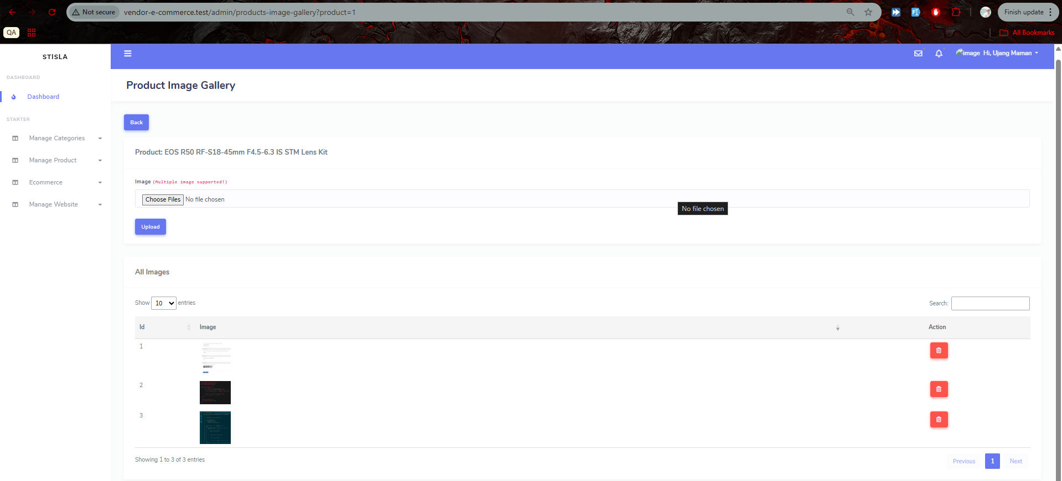
.

Slide 4
.

